Slide 1













MORE VISIBLE EUROPE!
9th
EUROPEAN PICNIC
31 AUG-2 SEP, 2018, BREZOVA
SUPPORTED BY

Slide 2
UNITY
SOLIDARITY
COHESION
REPORT

Slide 3
UNITY
SOLIDARITY
COHESION
Common success
and
common plans
make unity

Slide 4
UNITY
SOLIDARITY
COHESION
REPORT
COMMON
SUCCESS
COMMON
PLANS

Slide 5
UNITY
SOLIDARITY
COHESION
In order to build & strengthen
unity
in the European Union,
we need common future plans

Slide 6
UNITY
SOLIDARITY
COHESION
Common future plans
REPORT
European Commission
Priorities 2015 - 2019
Jobs, growth and investment
Digital single market
Energy union and climate
Internal market
A deeper and fairer economic
and monetary union
A balanced and progressive
trade policy to harness globalisation
Justice and fundamental rights
Migration
A stronger global actor
Democratic change
Making the EU more democratic

Slide 7
UNITY
SOLIDARITY
COHESION
Making the EU more democratic
REPORT
Bring EU closer to its citizens
Increase activity of the citizens
Support civil organisations as place-d’arm for activities

Slide 8

UNITY
SOLIDARITY
COHESION
REPORT
White paper on the future of Europe and the way forward

Slide 9
UNITY
SOLIDARITY
COHESION
Carrying On:
The EU27 focuses on delivering its positive reform agenda
Nothing but the Single Market:
The EU27 is gradually re-centred on the single market
Those Who Want More Do More:
The EU27 allows willing Member States to do more together in specific areas
Doing Less More Efficiently:
The EU27 focuses on delivering more and faster in selected policy areas, while doing less elsewhere
Doing Much More Together:
Member States decide to do much more together across all policy areas
REPORT
White Paper
on the future of Europe

Slide 10
UNITY
SOLIDARITY
COHESION
REPORT
EU motto:
In varietate concordia
Unity in the diversity

Slide 11
UNITY
SOLIDARITY
COHESION
For solidarity,
we need common goals
and belief based on the past
that together we achieve
common goals easier

Slide 12
UNITY
SOLIDARITY
COHESION
Solidarity
REPORT
one for all and all for one

Slide 13
UNITY
SOLIDARITY
COHESION
Solidarity
REPORT
one for all and all for one
Everybody can be sure one will not be left alone in trouble

Slide 14
UNITY
SOLIDARITY
COHESION
Solidarity
REPORT
one for all and all for one
Everybody can be sure one will not be left alone in trouble
Solidarity is based on cohesion

Slide 15
UNITY
SOLIDARITY
COHESION
Solidarity
REPORT
one for all and all for one
Everybody can be sure one will not be left alone in trouble
Solidarity is based on cohesion
Solidarity is rather a moral issue, not materialistic

Slide 16
UNITY
SOLIDARITY
COHESION
Solidarity
REPORT
one for all and all for one
Everybody can be sure one will not be left alone in trouble
Solidarity is not against national interests
National interests must be in harmony with unity

Slide 17
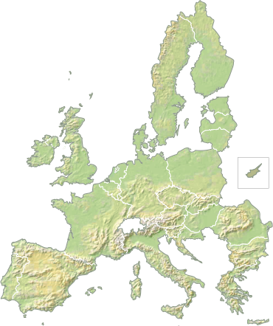
UNITY
SOLIDARITY
COHESION
Thank you for your attention!

